Slide 1
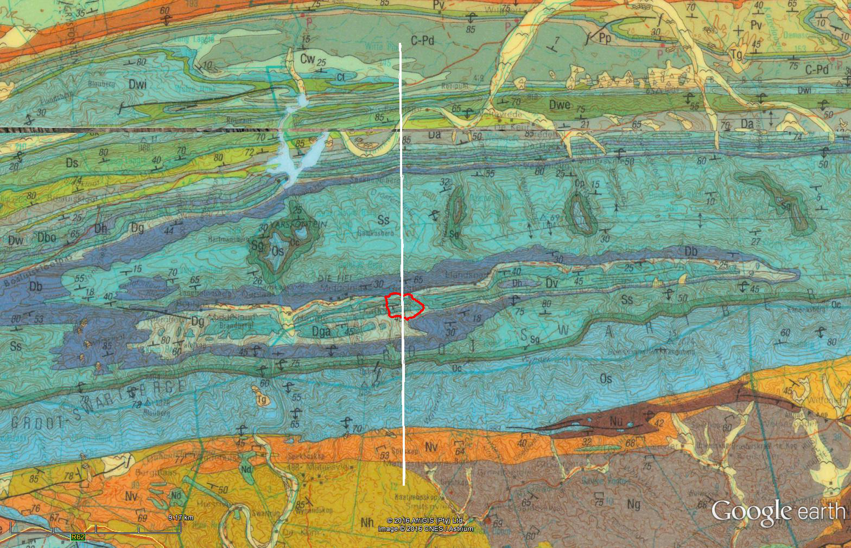

X-section I-J
See Cross section locations.kmz & Cross section labels.kmz for location in Google Earth
I
Grootkloof Trail
J

Slide 2
Schematic Geologic N-S Cross Section – looking East
Vertical exaggeration: 2.3x
Gamka River
Die Hel Road
Groot Swartberge
Km
Gamkaberg
1.5
I
J
1.0
Ss
Sg
Grootkloof Trail
Oc
Sg
Db
Ss
Oc
0.5
Cw
C-Pd
Dg
Dga
Os
Cf
Ck
Os
SL
Dwi
Dwe
Dwl
Dwa
Da
Db
-0.5
Dwu
Ss
Dbo
Dh
Dw
Dv
Dg
Dga
Db
Oc
Sg
-1.0
Ss
Os
Os
Nv, Ng, Nh
-1.5
Nv, Ng, Nh
-2.0
0
5
10
15
20
25 km

Slide 3
Stratigraphic Divisions and Age
Gamka River
Die Hel Road
Groot Swartberge
Km
Gamkaberg
1.5
I
J
1.0
Ss
Sg
Grootkloof Trail
Oc
Sg
Db
Ss
Oc
0.5
Cw
C-Pd
Dga
Os
Cf
Ck
Os
Dg
SL
Dwi
Dwe
Dwl
Dwa
Da
Db
-0.5
Dwu
Ss
Dbo
Dh
Dw
Dv
Dg
Dga
Db
Oc
Os
Ss
-1.0
Sg
Os
Nv, Ng, Nh
-1.5
Nv, Ng, Nh
-2.0
0
5
10
15
20
25 km
298 Ma
358 Ma
416 Ma
440 Ma
495 Ma

Slide 4
Supergroups
Gamka River
Die Hel Road
Groot Swartberge
Km
Gamkaberg
1.5
I
J
1.0
Ss
Sg
Grootkloof Trail
Oc
Sg
Db
Ss
Oc
0.5
Cw
C-Pd
Dga
Os
Cf
Dg
Ck
Os
SL
Dwi
Dwe
Dwl
Dwa
Da
Db
-0.5
Dwu
Ss
Dbo
Dh
Dw
Dv
Dg
Dga
Db
Oc
Sg
-1.0
Ss
Os
Os
Nv, Ng, Nh
Nv, Ng, Nh
-1.5
-2.0
0
5
10
15
20
25 km

Slide 5
Groups
Gamka River
Die Hel Road
Groot Swartberge
Km
Gamkaberg
1.5
I
J
1.0
Ss
Sg
Grootkloof Trail
Oc
Sg
Db
Ss
Oc
0.5
Cw
C-Pd
Dga
Os
Cf
Ck
Os
Dg
SL
Dwi
Dwe
Dwl
Dwa
Da
Db
-0.5
Dwu
Ss
Dbo
Dh
Dw
Dv
Dg
Dga
Db
Oc
Os
Sg
-1.0
Ss
Os
Nv, Ng, Nh
Nv, Ng, Nh
-1.5
-2.0
0
5
10
15
20
25 km
Profile Seekoegat to De Rust.xlsx

